Slide 1
UNIT II (PART II)
COSTS OF PRODUCTION

Slide 2
WHAT ARE COSTS?
Costs of production relate to the different expenses that a firm incur in producing a good or service.

Slide 3
Total Revenue, Total Cost, and Profit
Total Revenue
The amount a firm receives for the sale of its output.
Total Cost
The market value of the inputs a firm uses in production.

Slide 4
Total Revenue, Total Cost, and Profit
Profit is the firm’s total revenue minus its total cost.
Profit = Total revenue - Total cost

Slide 5
Costs as Opportunity Costs
A firm’s cost of production includes all the opportunity costs of making its output of goods and services.
Explicit and Implicit Costs
A firm’s cost of production include explicit costs and implicit costs.
Explicit costs are input costs that require a direct outlay of money by the firm.
Implicit costs are input costs that do not require an outlay of money by the firm.

Slide 6
Economic Profit versus Accounting Profit
Economists measure a firm’s economic profit as total revenue minus total cost, including both explicit and implicit costs.
Accountants measure the accounting profit as the firm’s total revenue minus only the firm’s explicit costs.

Slide 7
Economic Profit versus Accounting Profit
When total revenue exceeds both explicit and implicit costs, the firm earns economic profit.
Economic profit is smaller than accounting profit.

Slide 8
Figure 1 Economists versus Accountants
How an Economist
How an Accountant
Views a Firm
Views a Firm
Economic
profit
Accounting
profit
Implicit
Revenue
costs
Revenue
Total
opportunity
costs
Explicit
Explicit
costs
costs

Slide 9
THE VARIOUS MEASURES OF COST
Costs of production may be divided into fixed costs and variable costs.
Fixed costs are those costs that do not vary with the quantity of output produced.
Variable costs are those costs that do vary with the quantity of output produced.

Slide 10
Internal vs External Costs
Internal costs:
Refer to the direct monetised costs (planning, construction, management, maintenance, disposal) for a person or organisation undertaking an activity.
External costs (also known as externalities)
Refer to the economic concept of uncompensated social or environmental effects.
For example, when people buy fuel for a car, they pay for the production of that fuel (an internal cost), but not for the costs of burning that fuel, such as air pollution.

Slide 11
Private and Social Costs
Private Costs:
Costs we have to actually pay for any activity
Eg: owning and driving a car
It is private cost because it is specific to an individual.
Social Costs:
Social costs= private cost plus externalities (external costs)

Slide 12
Negative vs Positive Etxernality
Negative Externality:
Eg: Air pollution from motor vehicle
Positive Externality:
Education, health, labour training in firms

Slide 13
Fixed and Variable Costs
Total Costs
Total Fixed Costs (TFC)
Total Variable Costs (TVC)
Total Costs (TC)
TC = TFC + TVC

Slide 14
Fixed and Variable Costs
Average Costs
Average costs can be determined by dividing the firm’s costs by the quantity of output it produces.
The average cost is the cost of each typical unit of product.

Slide 15
Fixed and Variable Costs
Average Costs
Average Fixed Costs (AFC)
Average Variable Costs (AVC)
Average Total Costs (ATC)
ATC = AFC + AVC

Slide 16
Average and Marginal Costs

Slide 17
Average and Marginal Costs
Marginal Cost
Marginal cost (MC) measures the increase in total cost that arises from an extra unit of production.
Marginal cost helps answer the following question:
How much does it cost to produce an additional unit of output?

Slide 18
Average and Marginal Cost

Slide 19
The various measures of cost: Conrad’s coffee shop
Quantity of coffee (cups per hour) | Total Cost | Fixed Cost | Variable Cost | Average Fixed Cost | Average Variable Cost | Average Total Cost | Marginal Cost
0 1 2 3 4 5 6 7 8 9 10 | $3.00 3.30 3.80 4.50 5.40 6.50 7.80 9.30 11.00 12.90 15.00 | $3.00 3.00 3.00 3.00 3.00 3.00 3.00 3.00 3.00 3.00 3.00 | $0.00 0.30 0.80 1.50 2.40 3.50 4.80 6.30 8.00 9.90 12.00 | - $3.00 1.50 1.00 0.75 0.60 0.50 0.43 0.38 0.33 0.30 | - $0.30 0.40 0.50 0.60 0.70 0.80 0.90 1.00 1.10 1.20 | - $3.30 1.90 1.50 1.35 1.30 1.30 1.33 1.38 1.43 1.50
$0.30 0.50 0.70 0.90 1.10 1.30 1.50 1.70 1.90 2.10

Slide 20
Conrad’s total-cost curve
Total Cost
$15.00
14.00
Total-cost curve
13.00
12.00
11.00
10.00
9.00
8.00
7.00
6.00
5.00
4.00
3.00
2.00
1.00
1
2
3
4
5
6
7
8
9
Quantity of Output
(cups of coffee per hour)
0
10
Here the quantity of output produced (on the horizontal axis) is from the first column in Table 2, and the total cost (on the vertical axis) is from the second column. As in Figure 2, the total-cost curve gets steeper as the quantity of output increases because of diminishing marginal product.

Slide 21
Cost Curves and Their Shapes
Marginal cost rises with the amount of output produced.
This reflects the property of diminishing marginal product.

Slide 22
Cost Curves and Their Shapes
The average total-cost curve is U-shaped.
At very low levels of output average total cost is high because fixed cost is spread over only a few units.
Average total cost declines as output increases.
Average total cost starts rising because average variable cost rises substantially.

Slide 23
Cost Curves and Their Shapes
The bottom of the U-shaped ATC curve occurs at the quantity that minimizes average total cost. This quantity is sometimes called the efficient scale of the firm.

Slide 24
Cost Curves and Their Shapes
Relationship between Marginal Cost and Average Total Cost
Whenever marginal cost is less than average total cost, average total cost is falling.
Whenever marginal cost is greater than average total cost, average total cost is rising.

Slide 25
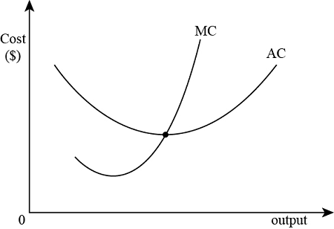
Relationship between Marginal and Average Costs

Slide 26
Cost Curves and Their Shapes
Relationship between Marginal Cost and Average Total Cost
The marginal-cost curve crosses the average-total-cost curve at the efficient scale.
Efficient scale is the quantity that minimizes average total cost.

Slide 27
Typical Cost Curves
It is now time to examine the relationships that exist between the different measures of cost.

Slide 28
Cost Curves for a Typical Firm
Note how MC hits both ATC and AVC at their minimum points.
Marginal Cost declines at first and then increases due to diminishing marginal product.
Costs
$3.00
AFC, a short-run concept, declines throughout.
2.50
MC
2.00
1.50
ATC
1.00
AVC
0.50
AFC
0
2
4
6
8
10
12
14
Quantity of Output

Slide 29
Typical Cost Curves
Three Important Properties of Cost Curves
Marginal cost eventually rises with the quantity of output.
The average-total-cost curve is U-shaped.
The marginal-cost curve crosses the average-total-cost curve at the minimum of average total cost.

Slide 30
COSTS IN THE SHORT RUN AND IN THE LONG RUN
For many firms, the division of total costs between fixed and variable costs depends on the time horizon being considered.
In the short run, some costs are fixed.
In the long run, all fixed costs become variable costs.
Because many costs are fixed in the short run but variable in the long run, a firm’s long-run cost curves differ from its short-run cost curves.

Slide 31
Long-run costs
Since all inputs are variable, all costs are variable in the long run.
Long-run average cost (LRAC) measures the long-run cost of producing one unit of output:

Slide 32
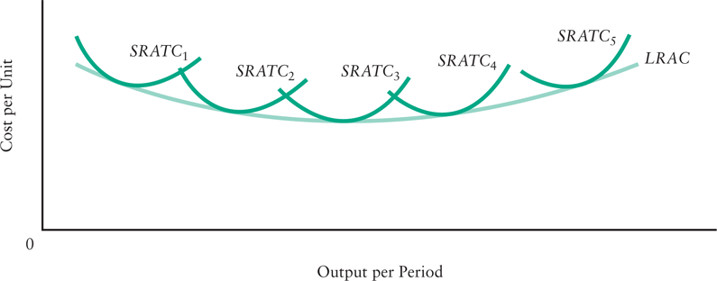
The Relationship between Short-Run Average Cost and Long-Run Average Cost
LRAC shows minimum average cost of producing any level of output when all inputs are variable

Slide 33
Economies and Diseconomies of Scale
Economies of scale refer to the property whereby long-run average total cost falls as the quantity of output increases.
Diseconomies of scale refer to the property whereby long-run average total cost rises as the quantity of output increases.
Constant returns to scale refers to the property whereby long-run average total cost stays the same as the quantity of output increases.

Slide 34
Average Total Cost in the Short and Long Run
Average
Total
ATC
in short
ATC
in short
ATC
in short
Cost
run with
run with
run with
small factory
medium factory
large factory
ATC
in long run
$12,000
10,000
Economies
Constant
of
returns to
scale
scale
Diseconomies
of
scale
0
1,000
1,200
Quantity of
Cars per Day

Slide 35
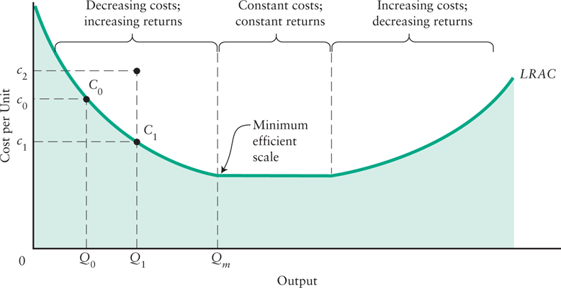
Return to scale
what happens to LRAC as a firm increases its plant size

Slide 36
Summary
The goal of firms is to maximize profit, which equals total revenue minus total cost.
When analyzing a firm’s behavior, it is important to include all the opportunity costs of production.
Some opportunity costs are explicit while other opportunity costs are implicit.

Slide 37
Summary
A firm’s costs reflect its production process.
A typical firm’s production function gets flatter as the quantity of input increases, displaying the property of diminishing marginal product.
A firm’s total costs are divided between fixed and variable costs. Fixed costs do not change when the firm alters the quantity of output produced; variable costs do change as the firm alters quantity of output produced.

Slide 38
Summary
Average total cost is total cost divided by the quantity of output.
Marginal cost is the amount by which total cost would rise if output were increased by one unit.
The marginal cost always rises with the quantity of output.
Average cost first falls as output increases and then rises.

Slide 39
Summary
The average-total-cost curve is U-shaped.
The marginal-cost curve always crosses the average-total-cost curve at the minimum of ATC.
A firm’s costs often depend on the time horizon being considered.
In particular, many costs are fixed in the short run but variable in the long run.

Slide 40
Summary
Total fixed costs | Costs that do not depend on the quantity of output produced. These must be paid even if output is zero. | TFC
Total variable costs | Costs that vary with the level of output. | TVC
Total cost | The total economic cost of all the inputs used by a firm in production. | TC = TFC + TVC
Average fixed costs | Fixed costs per unit of output. | AFC = TFC/Q
Average variable costs | Variable costs per unit of output. | AVC = TVC/Q
Average total costs | Total costs per unit of output. | ATC = TC/Q ATC = AFC + AVC
Marginal costs | The increase in total cost that results from producing one additional unit of output. | MC = ΔTC/ΔQ

